Slide 1
Quick Cart Sales & Operations Analysis
End-to-End Data Analytics Project
Tools: Python | MySQL | Power BI

Slide 2
Project Overview
Quick Cart is an e-commerce grocery platform operating across multiple cities.
Goal: Analyze order data to identify sales trends, delivery efficiency, inventory risks, and payment behavior.
Workflow:
• Python – Data Cleaning
• MySQL – Data Analysis
• Power BI – Data Visualization

Slide 3
Business Objectives
• Identify top-performing product categories
• Track sales performance by city
• Evaluate delivery efficiency
• Monitor inventory risks
• Understand customer satisfaction
• Analyze payment method trends

Slide 4
Dataset Description
Dataset contains 1,200 order records.
Key columns:
• Product Category
• Product Name
• City
• Order Date
• Delivery Partner
• Delivery Time
• Customer Rating
• Payment Method
• Stock Status
• Revenue

Slide 5
Data Cleaning – Python
Cleaning tasks performed:
• Removed duplicate records
• Handled missing values
• Standardized column names
• Converted data types
• Created new columns (Year, Month, Day, Delivery Speed, Stock Status)
Libraries used: Pandas, NumPy

Slide 6
Data Analysis – MySQL
Dataset imported into MySQL database.
SQL queries used to analyze:
• Revenue and order metrics
• Sales by city and category
• Delivery partner performance
• Payment method distribution
• Inventory stock analysis

Slide 7
Overall Business Performance
Total Revenue: 503,233
Total Orders: 1,200
Avg Customer Rating: 3.97
Avg Delivery Time: 30.19 minutes

Slide 8
Top Product Categories
Revenue by Category:
• Bakery – 90,664
• Fruits – 87,343
• Snacks – 85,740
• Beverages – 84,968
• Frozen – 82,096
• Dairy – 72,422
Insight: Bakery generates the highest revenue.

Slide 9
Sales by City
Revenue by City:
• Delhi – 94,077
• Pune – 90,839
• Mumbai – 84,543
• Bangalore – 78,966
• Hyderabad – 78,136
• Chennai – 76,672
Insight: Delhi and Pune are the strongest markets.

Slide 10
Delivery Performance
Fastest Delivery Partner: Vikram (27.96 min)
Slowest Delivery Partner: Arjun (31.48 min)
Highest Customer Rating: Karthik (4.05)
Insight: Delivery efficiency varies across partners.

Slide 11
Payment & Inventory Analysis
Payment Methods:
• Wallet – 308
• COD – 300
• Card – 299
• UPI – 293
Inventory Status:
• In Stock – 782 orders
• Low Stock – 418 orders
Insight: Low stock items still generate high demand.

Slide 12
Power BI Dashboard
Interactive dashboard built in Power BI.
Visuals include:
KPI Cards
Revenue by Category
Monthly Sales Trend
Orders by City
Delivery Efficiency
Payment Method Distribution
Stock Status Analysis

Slide 13
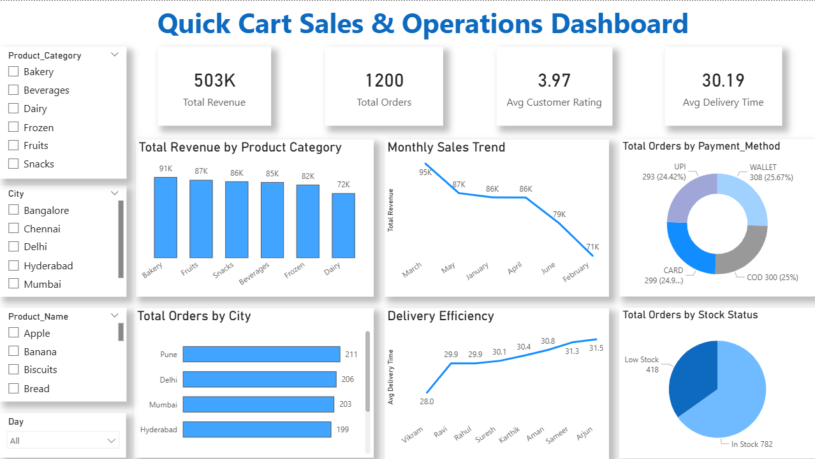
Quick Cart Sales & Operations Dashboard Was created using Power BI to visualize key business insights.

Slide 14
Key Business Insights
Bakery is the highest revenue category
Delhi & Pune generate the most sales
Vikram is the fastest delivery partner
Karthik has the highest rating
Wallet payments slightly dominate
418 orders come from low-stock products

Slide 15
Business Recommendations
Improve Inventory Planning
Low-stock products generate significant orders. Quick Cart should improve stock forecasting to prevent product shortages.
Focus on High-Demand Cities
Cities like Delhi and Pune should receive more marketing and supply attention to maximize revenue.
Optimize Delivery Operations
Analyse the performance of faster delivery partners to improve overall delivery efficiency.
Encourage Digital Payments
Promote wallet and UPI payments through offers or cashback programs.

Slide 16
Conclusion
This project demonstrates an end-to-end data analytics workflow.
Python → Data Cleaning
MySQL → Data Analysis
Power BI → Visualization
The insights support data-driven decisions to improve sales and operations.

